Slide 1



Lead Scoring
Case Study
Submitted By-
TRIVENI

Slide 2
PROBLEM STATEMENT
X Education in the Ed-Tech Industry sells online courses to industry professionals.
It’s lead conversion is very poor.
The company wants to assign Lead Score to each lead using
_{A}M_{s}ac_{s}h_{u}in_{m}e Le_{p}ar_{t}n_{i}i_{o}ng_{n}M_{s}odel.
Unique value variables like ‘Prospect ID’ and Single value variables are dropped as they do not provide any significant information.
Variables with high missing values and data imbalances are also not considered

Slide 3
APPROACH FOLLOWED
Data Cleaning and Data Manipulation
Exploratory Data Analysis
Data Pre-processing
Model Building - Logistic Regression Model
Model Evaluation
Predictions
Conclusions and Recommendations

Slide 4
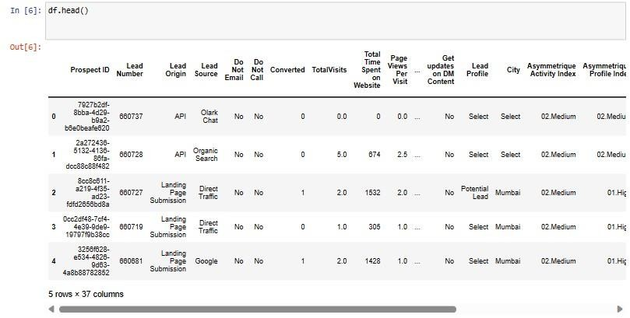
Notable EDA Conclusions

Slide 5
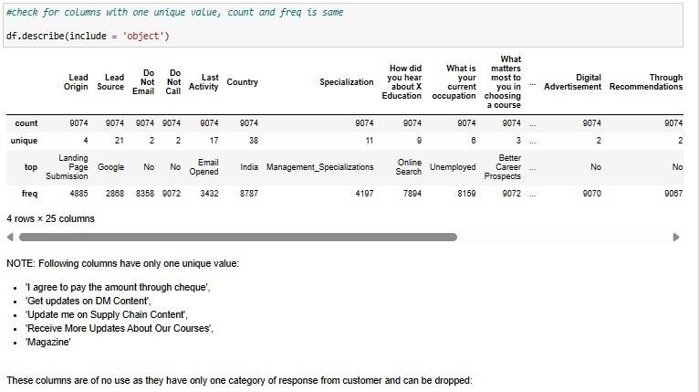
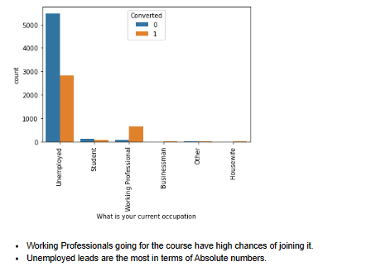
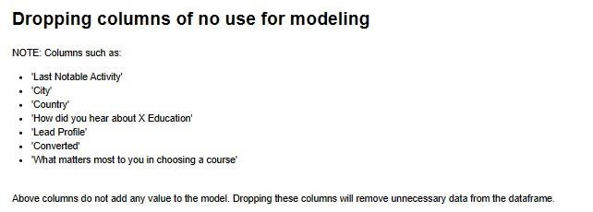
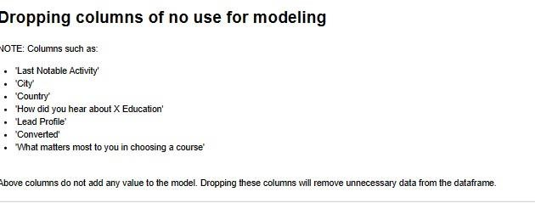
Notable EDA Conclusions

Slide 6
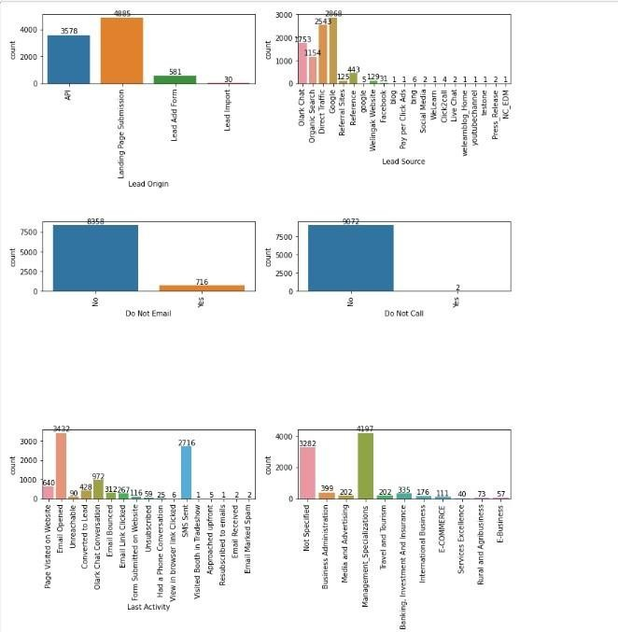
Notable EDA Conclusions

Slide 7
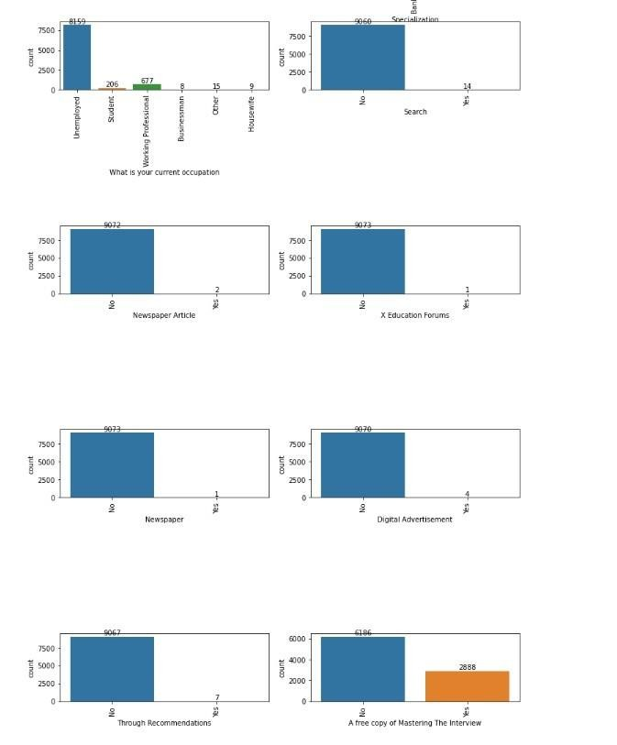
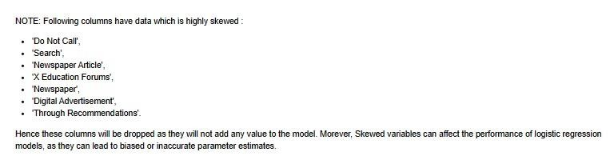

Slide 8
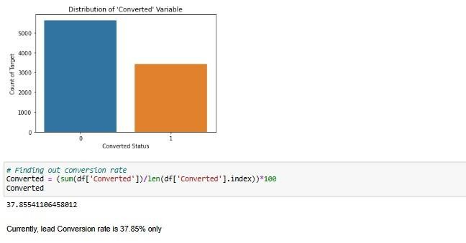
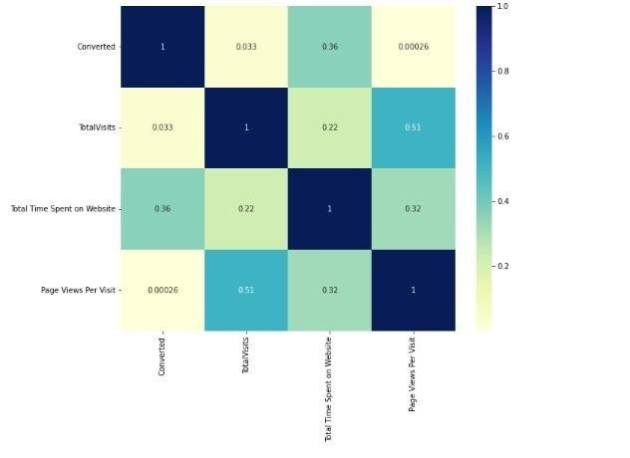
The top three variables that contribute most towards the probability of a lead getting converted are
Total Time Spent on Website
Lead Source_Welingak Website
Lead Source_Reference

Slide 9
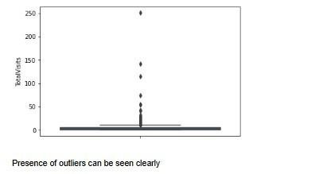
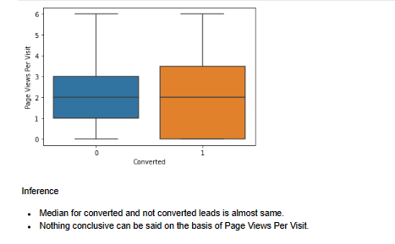
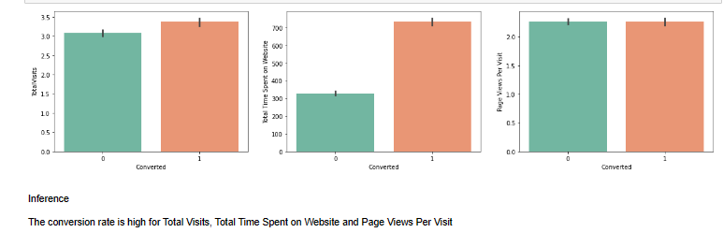

Slide 10
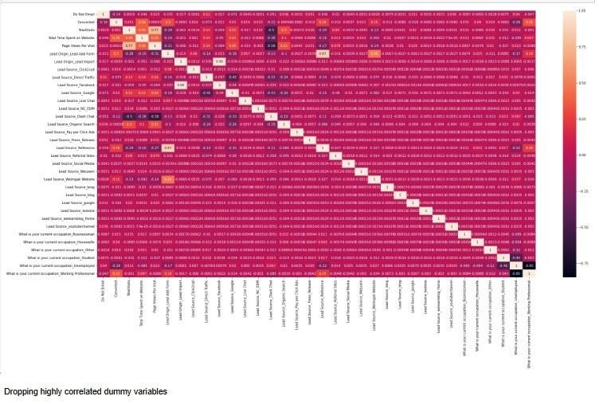
NOTABLE EDA CONCLUSIONS (CONT.)

Slide 11
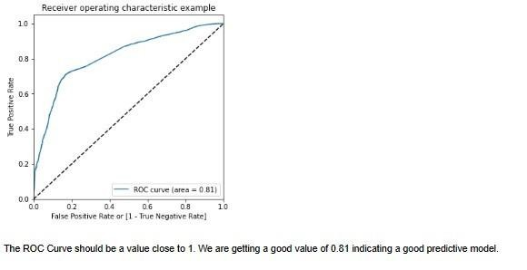
RESULTS
• ROC Curve
96% of the area is under ROC curve.
Classification Probability of lead conversion by the model is very high

Slide 12
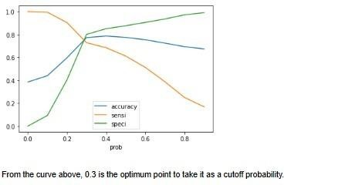
NOTABLE EDA CONCLUSIONS (CONT.)
0.3 is the optimum point to take it as a cut-off probability.
Accuracy : 77.45%
Sensitivity :71.58%
Specificity : 80.79%

Slide 13
RECOMMENDATIONS
Follow ups through calls and emails with high conversion probability leads is suggested.
Focus more on customers who spend a lot of time on the company’s website as their conversion rate is high as per EDA.
Providing special offers to customers who are highly interested and are seen visiting back to the website.
Leads who have Tags such as ‘Ringing’, ‘Switched Off’, ‘Invalid Number’ can be avoided as the probability of them converting is very low.

Slide 14
Thank You !

